Slide 1

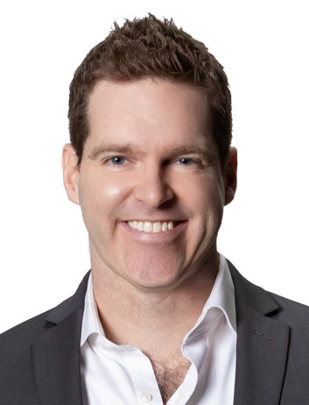
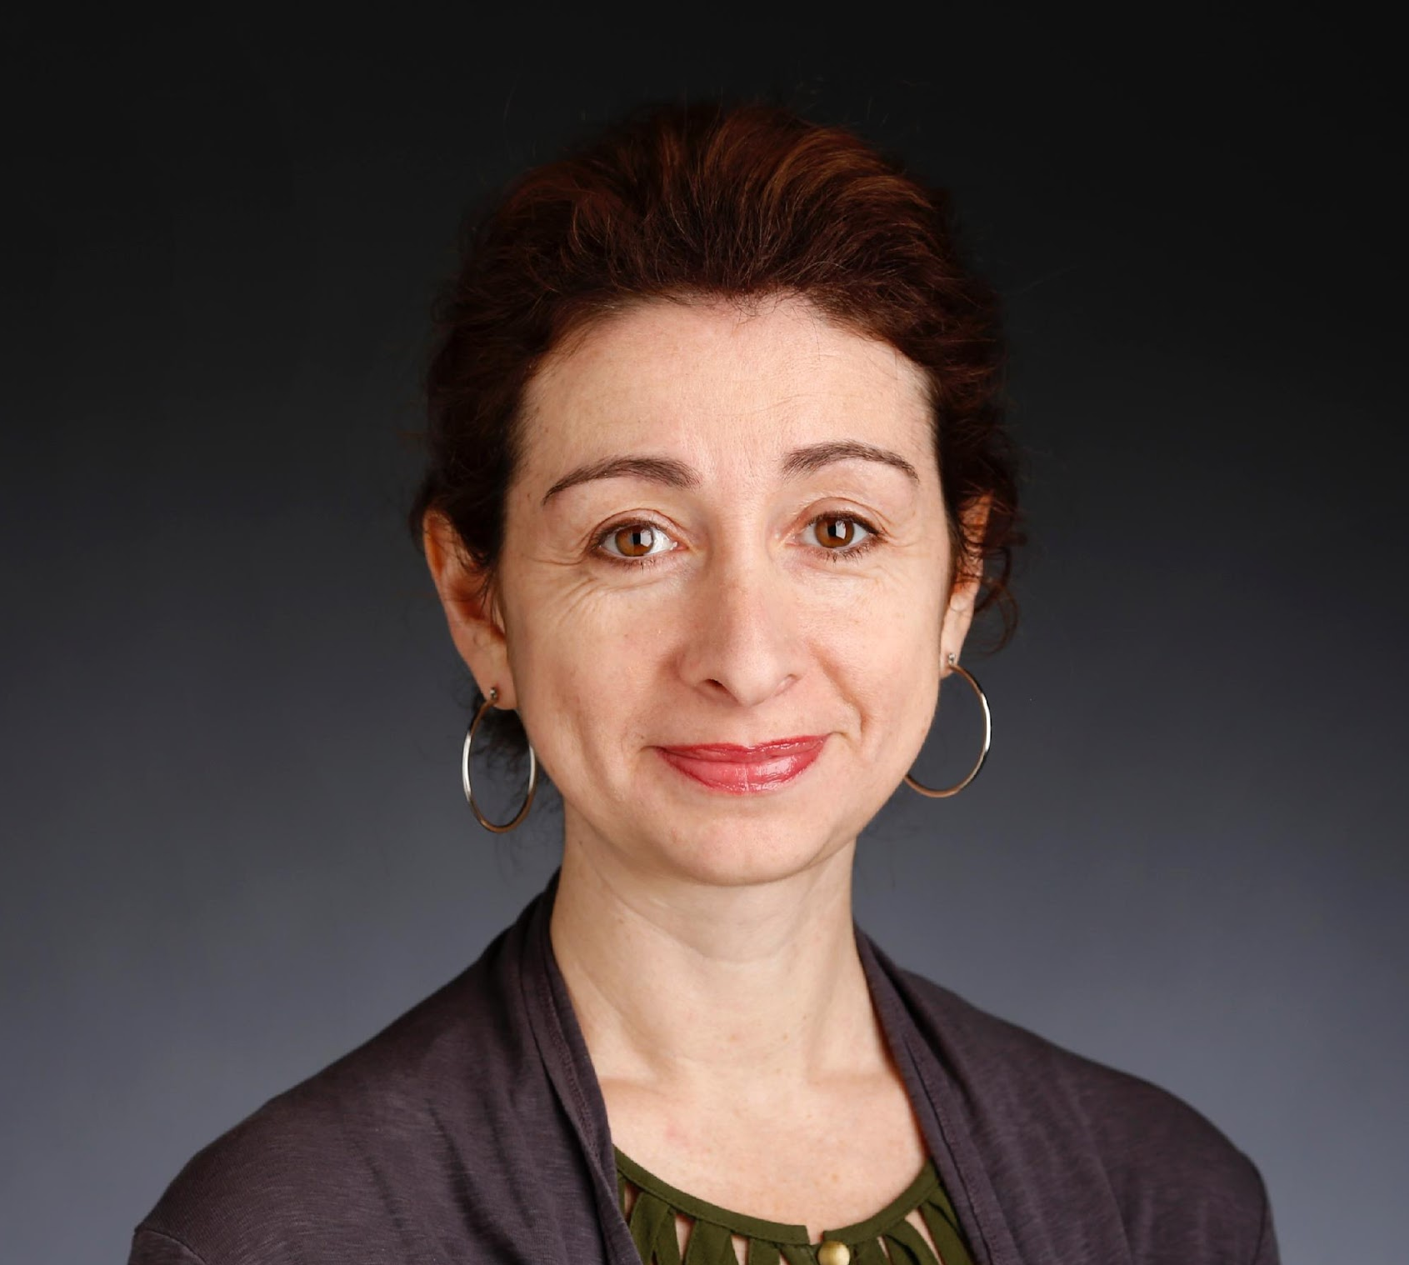
WeConnect Workshop, November 11, 2022
“Writing a Feature Article”
with guest presenters:
Moderated by Robert Hornsby, Asso. Vice Pres., Internal Communications
John Tucker, Cleveland Plain Dealer | Anna Kuchment, Boston Globe

Slide 2
For discussion – Elements of Story:
Character
    Access
Narrative
Tension/conflict
    Structure
Broader context
    Timing
New findings/data
Universal emotion

Slide 3
Attributes of good storytelling:
Put a person into the story – a profile or story told through their eyes/experience
Show the impact of how your news/issue affects a person(s)
Explain causation or history
Use analogy to make news relatable to a more common experience
Make it visual – photos, graphics & video now more important than ever
Other?

Slide 4
But is the story worth the effort?
News value – Why is this item “news” or newsworthy; what are the elements that give it news value?
Audience – Who will or should care about your story? How valuable are they to your program? How will you reach them?
Author – Is that you or someone else, like a freelancer or an external journalist?
Imperative – What or who is motivating the story? An important occurrence or event, a departmental mandate, or a directive from some higher authority?
Time & resources – how much of your time will it take to produce this content, and will there be other expenses, such as photography?
Exercise: Pick a story idea. Rate it 1-5 for each of the above (5 is best). Average the score. If it has an average score of 2.0 or below, is it still worth producing this story?

Slide 5
Resources:
ELLE
The Unlikely Story of a Sex Trafficking Survivor and the Instagram Account That Saved Her Life
Cleveland Plain Dealer
Stay a while: Longtime Guardians fan has a special home during a special season
Dallas Morning News
Muslim teen detained over clock he made
Boston Globe
Some doctors are reluctant to care for patients with disabilities, study finds

Slide 6
For more information or to share ideas, contact:
  Robert Hornsby
  r.hornsby@columbia.edu
  Cassandra Nathan
  cm2891@columbia.edu

